Slide 1
Voter Turnout Prediction
Unlocking Patterns in Voter Participation: Predicting Turnout with Data-Driven Insights.
Anushka Chakraborty
MSc Data Science
Chennai Mathematical Institute

Slide 2
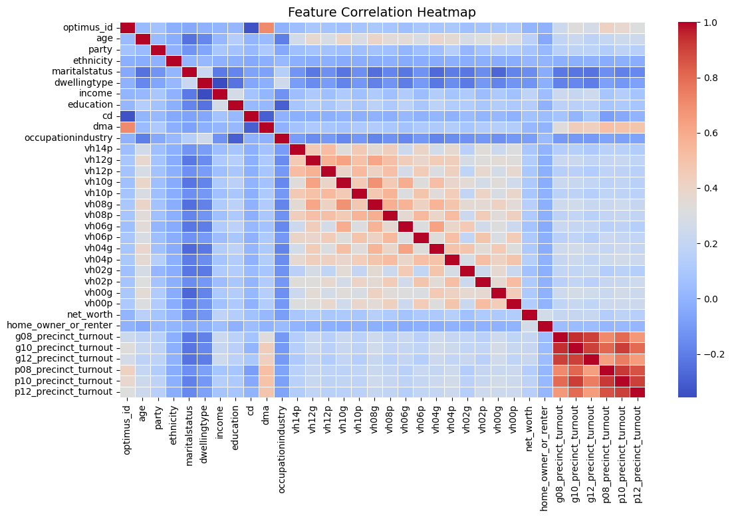
Correlation between different features
1. Strong Correlation Among Voter History Features
2. Precinct Turnout Correlation
`g08_precinct_turnout`
`g10_precinct_turnout`
`g12_precinct_turnout`
`p08_precinct_turnout`
`p10_precinct_turnout`
`p12_precinct_turnout`
are highly correlated, suggesting consistent precinct-level voting trends over multiple election cycles.
3. Minimal Correlation Between Demographics(ethnicity and marital status) and Voting Behavior
4. Low Correlation Between Socioeconomic Factors (Occupation/Industry, income, education, dwelling type) and Voting

Slide 3
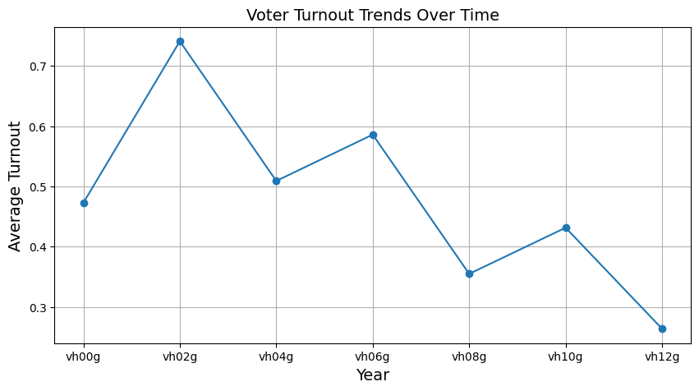
Trend of Voters Turnout over Time
1. Peak in 2002: The highest voter turnout was recorded in 2002.
2. Decline After 2002: A noticeable decline followed in 2004, indicating a drop in voter participation.
3. Slight Recovery in 2006: Turnout increased again in 2006 before declining in 2008.
4. Steady Drop in 2008 and 2012: The lowest turnout was observed in 2012, continuing the downward trend.
5. Fluctuating Pattern: Turnout rates do not follow a linear trend, indicating variability in voter engagement across different years.
6. Potential Influences: Political, economic, or social factors may have contributed to the observed turnout changes.

Slide 4
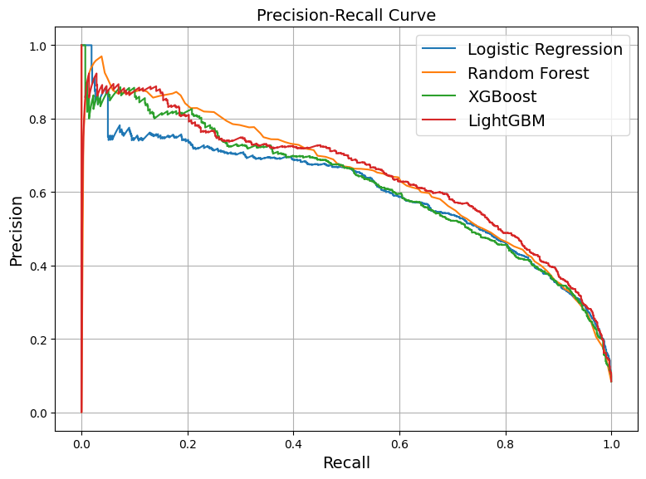
Precision-Recall Curve
1. Initial Dip
Both Random Forest (orange) and LightGBM (red) show a sharp dip at very low recall values before stabilizing.
This indicates that both models initially struggle with precision at extreme recall values.
2. Performance Comparison
Random Forest and LightGBM alternate in leading performance:
At certain recall values, Random Forest exhibits higher precision.
At other points, LightGBM surpasses Random Forest.
This suggests that their performance is closely matched and fluctuates based on recall.
3. General Trends
LightGBM and XGBoost (green) have similar trends, but LightGBM slightly outperforms at times.
Logistic Regression (blue) lags behind in precision across most recall values.
The overall shape of the curves suggests that tree-based ensemble methods (Random Forest, XGBoost, LightGBM) provide superior performance over logistic regression.

Slide 5
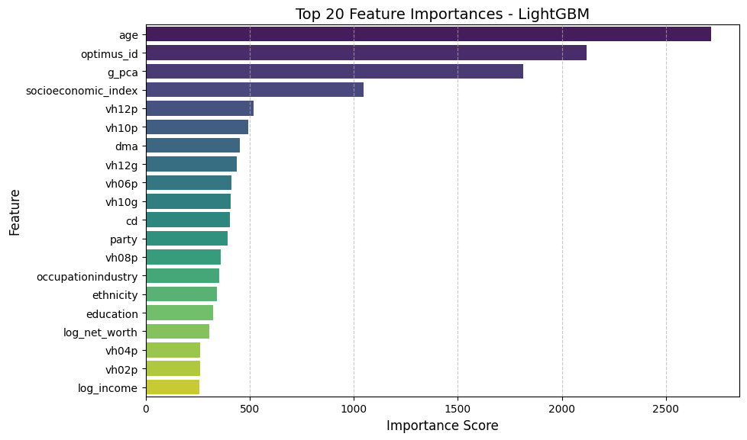
Top 20 features affecting voters turnout
Age is the most influential factor in predicting voter turnout, indicating that older individuals may have different voting behaviors compared to younger ones.
Optimus ID and g_pca (represent past voter turnout percentages in different elections) rank highly, suggesting potential correlations with key demographic or behavioral patterns.
Socioeconomic index plays a significant role, highlighting the impact of economic status on voter participation.
Past voting behavior features (vh12p, vh10p, etc.) are strongly relevant, reinforcing the idea that previous voting history is a strong predictor of future turnout.
Demographic and socioeconomic factors like education, ethnicity, and occupation/industry also contribute to the model’s predictions.
Log income and net worth appear lower on the list, but they still play a role, suggesting a moderate relationship between financial status and voting likelihood.

Slide 6
Conclusion
Key Predictors: Age, past voting behaviour, and socioeconomic status significantly influence voter turnout.
Model Performance: LGBM outperformed Logistic Regression, Random Forest and XGBoost in overall performance
Feature Engineering: PCA effectively reduced dimensionality while preserving critical information.
Precision-Recall Insights: LightGBM and Random Forest alternated in leading performance, depending on recall values.
Insights about the Voting Trends:
Voter Trends: Older individuals and those with a history of voting are more likely to participate in elections. However, younger demographics show lower engagement.
Declining Turnout: Over time, voting rates have seen fluctuations, with concerns about decreasing participation in certain groups.
Social & Economic Factors: Socioeconomic status, education, and past voting behavior play a crucial role in voter engagement.
Call to Action: Understanding these trends can help policymakers and organizations design targeted strategies to boost voter turnout and civic participation.

